Slide 1
AEP from scanning lidars
WORKSHOP
02-10-2018
DTU, Risø Campus, Roskilde
Notes:
I am …
Andreas Bechmann
Practical matters: coffee, toilet, wifi
RECAST: 3 year research project developing a solution to reduce the uncertainty of WRA assessment by using measureemtns at multiple positions over the site
Key = Scanning lidar
IFD, 4 partners

Slide 2
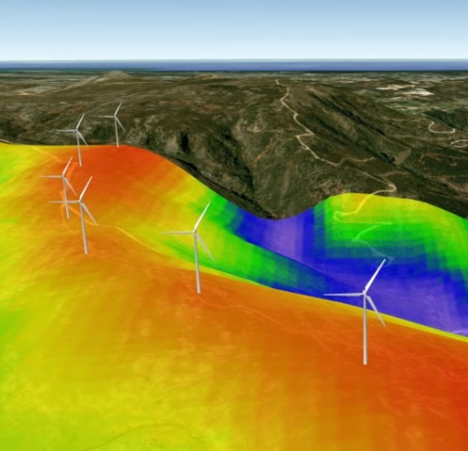
RECAST Vision
Holistic methodology for credible wind resource prediction
Using WindScanners
Use WindScanners to measure at multiple points over site
Lower microscale wind flow uncertainty
Shorter WRA (measurement) duration
Wind farm project more attractive to banks
Lead to increased AEP by >2%

Slide 3
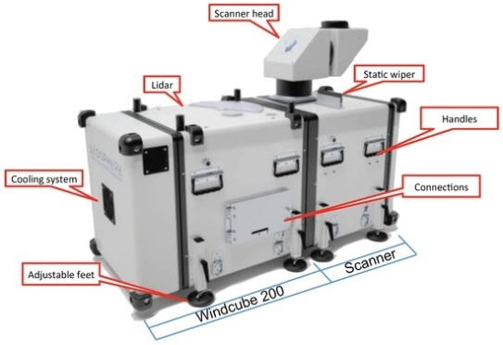
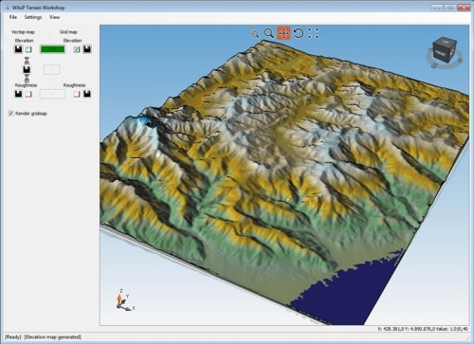
RECAST outcome
Decision tool
Windscanner measurements
Advanced microscale flow model
Smart measurement campaign design:
When and how long?
Where?
Uncertainty vs cost
User friendly WSS
(Automatic trajectory, Automatic data transfer)
Multi-point measurements
Notes:
Upgrade WAsP to use multi point measurments
Upgrade WS to userfriendly measurement device
Algorithm to determine where to measure
Use meso flow model to predict when and how long one should measure
Decision tool inc. cost vs uncertainty

Slide 4
RECAST project plan
2018
Kick off
2019
“Proof of concept”:
2020
Demonstration campaign
Development of uncertainty model
Development of WSS software
WAsP upgrade
Development of measurement campaign design tool(when? Where?)
Site suitability aspects
TI measurements using Wind scanner
Shear and TI long term extrapolation
AEP1=
1 mast *
12 months
AEP2=
5 masts * 4 months
vs
Windscanner deployment at RES site

Slide 5
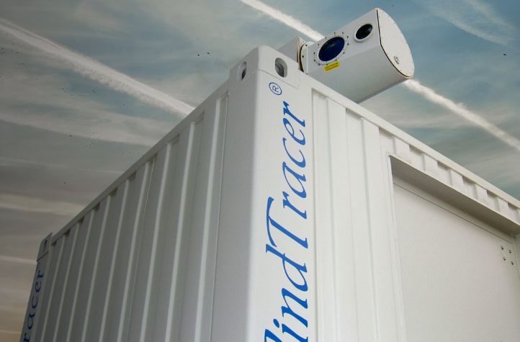
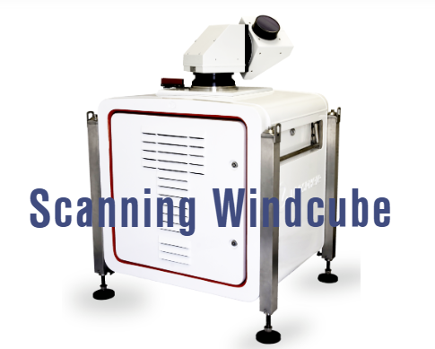
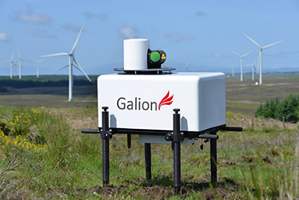
Scanning lidar
Wind lidar with laser beam that can be steered in any azimuth and elevation position

Slide 6
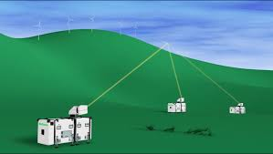
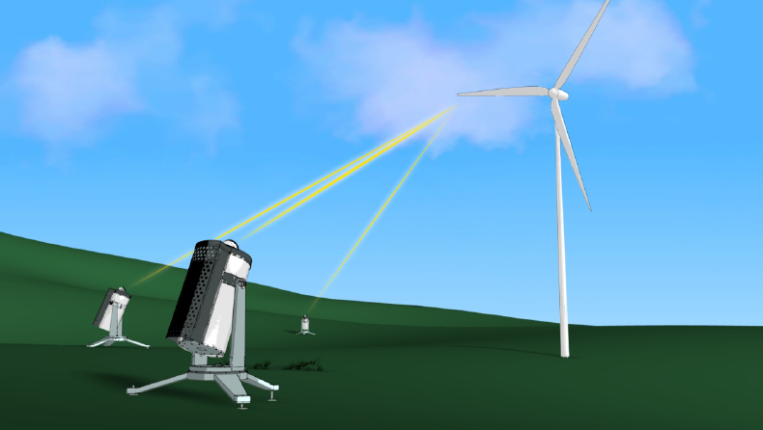
WindScanner
OEM Scanning lidar Hardware
+ DTU WindScanner software
WindScanner System (WSS):
Several Wind Scanners
+ Master computer to synchronise them

Slide 7
What is the opportunity?
MET. MAST
Erecting masts in complex terrain
Difficult, sometimes impossible?
Expensive
Limited number of masts (1or 2 per site)
SCANNING LIDARS
Lidars are
easier to deploy, mobile
Expensive
Scanning lidars can provide measurement at several positions without having to move the hardware
Lower micro flow model uncertainty
Lower AEP uncertainty
Lower risk and lower cost of energy
Allow higher uncertainty on LTC?

Slide 8
What is the opportunity? (continues)
MET. MAST
Good availability (except in cold conditions)
TI measurements
Best practices, standards
High acceptance
SCANNING LIDARS
Data availability can be an issue (e.g. fog, clean air)
TI measurements different from point measurements (volume averaging and cross-contamination)
Relatively new technology

Slide 9
Purpose of the Workshop
Gather key people to discuss:
How much are scanning lidars used for site assessment today?
What are the pros and cons?
What are the gaps/barriers preventing to use them more?
What could we do to close those gaps?

Slide 10
Agenda
9:00 What is the opportunity? (Rozenn Wagner, DTU) 9:40 Experience gained from Dublin Bay – “Scanning Lidars” (RES on behalf of OWA) 10:25 Coffee Break 10:45 Five years of success and failures with WindScanners (Nikola Vasiljevic, DTU) 11:30 Online Survey: The gaps for using Lidars for AEP? 12:00 Lunch + Demo of Windscanner 13:40 Experience gained from the floating LiDAR roadmap (Megan Smith – Carbon trust) 14:25 What should RECAST do to close gaps? (Coffee + breakout groups) 16:00 Plenum discussion: Findings of groups 16:30 The End

